Slide 1
African Americans in WWI
Unit 3 Section 1

Slide 2
African Americans Join The War Effort
The year is 1917, and America has just joined WWI. Millions of American citizens rush to sign up. But white Americans aren’t the only ones willing to risk their lives to defend the nation they love….

Slide 3
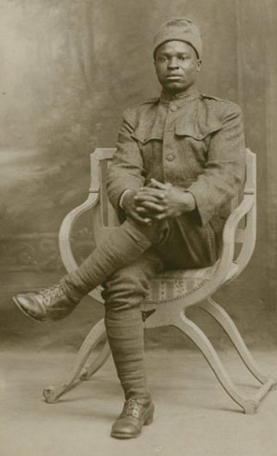
This man is Pvt. Eddie Riley, and he is just one of many African Americans who signed up to fight the good fight in WWI.
Notes:
The caption for this photo reads:
Black soldiers experienced many indignities after World War I, including not being allowed to celebrate the Allied victory. In Paris, the United States refused to allow any black American soldiers to march with other Allied soldiers, including colonial African troops, in the victory parade up the Champs-Elysées on Bastille Day in 1919.

Slide 4
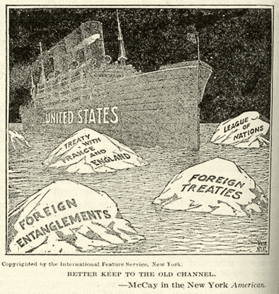
At the start of WWI, African Americans had the same feelings towards involvement in the war as whites did: the US should stay out of it.

Slide 5
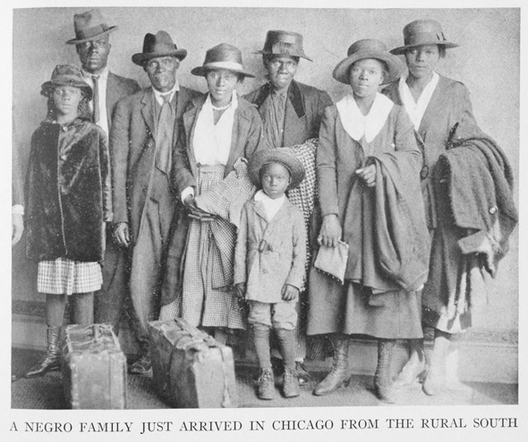
Coincidentally, the start of WWI also marked the beginning of what would become known as the Great Migration.
During this time, about 500,000 black southerners moved to the North.
Why?

Slide 6
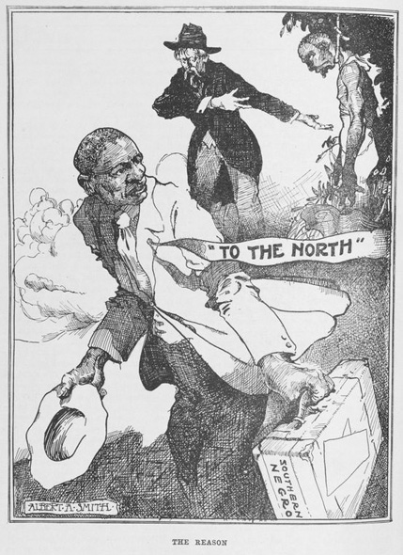
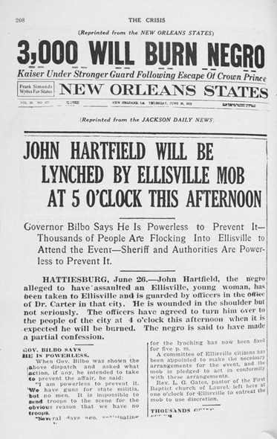
AA’s moved to the North because in the South they faced social, economic, and political problems.
Even though the Civil War had been over for quite a time, they faced racial prejudice, discrimination, and violence.
Notes:
Caption for newspaper:
The Crisis headlines an announcement of an upcoming lynching in Hattiesburg, Mississippi. Migration, military service, racial violence, and political protest combined to make the war years one of the most dynamic periods of the African-American experience.

Slide 7
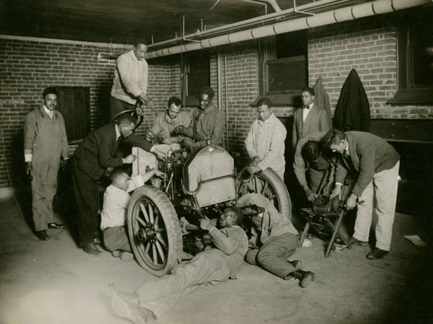
The North provided ample jobs and opportunities for AAs. The US at this time was a major industrial country, with most of that industry being in the North. The war provided the US with lots of business, and with European immigration cut of (because of the war) AAs were needed to fill the ever-growing number of jobs.
Notes:
Caption for Photo:
Job training at segregated training centers in northern cities provided African-American men with the skills to compete in the job market.

Slide 8
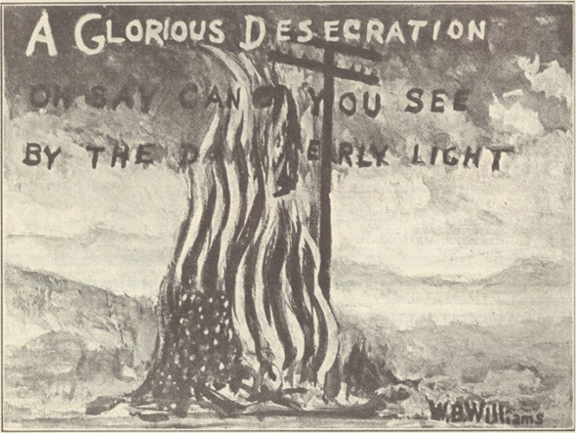
This does not mean that they did not face discrimination in the North.
This cartoon calls for the end to the discrimination.

Slide 9
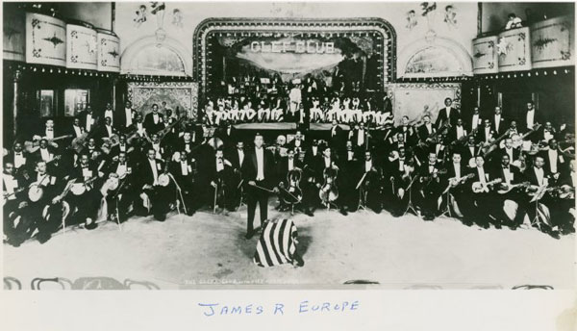
Free from the Jim Crow laws of the South, African American art, literature, and music flourished.
Notes:
Caption:
One of America's most popular bands, the Clef Club Company Orchestra, led by James Reese Europe, received enthusiastic reviews when they performed at Carnegie Hall and other well-known places in the United States.

Slide 10
MOVING ON!

Slide 11
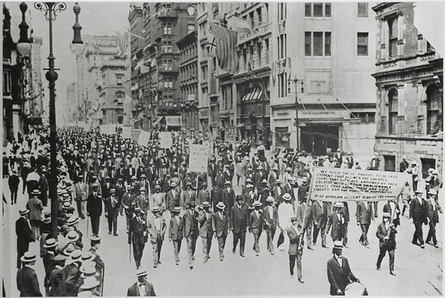
On April 2, 1917, President Woodrow Wilson made a public declaration of war against Germany and the Central Powers.
He said, “The world must be made safe for democracy.”
This statement immediately resonated with many AAs.
Notes:
Caption:
On July 28, 1917, more than eight thousand protesters solemnly marched down Fifth Avenue to the sound of muffled drums and holding signs, one of which read, MR. PRESIDENT, WHY NOT MAKE AMERICA SAFE FOR DEMOCRACY.

Slide 12
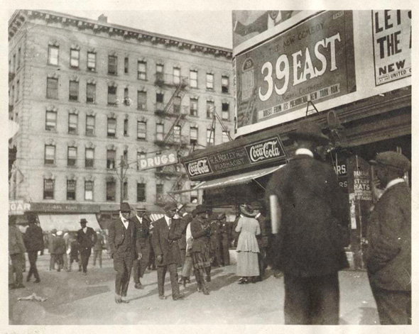
This statement resonated with many AAs because they viewed the war as an opportunity to bring about true democracy in the US.

Slide 13
It would be insincere, many black people argued, for the US to fight for democracy in Europe while AAs remained second-class citizens.
“If America truly understands the functions of democracy and justice, she must know that she must begin to promote democracy and justice at home first of all.”
-Arthur Shaw
of New York
Notes:
For African Americans, the war became a crucial test of America's commitment to the ideal of democracy and the rights of citizenship for all people, regardless of race.

Slide 14
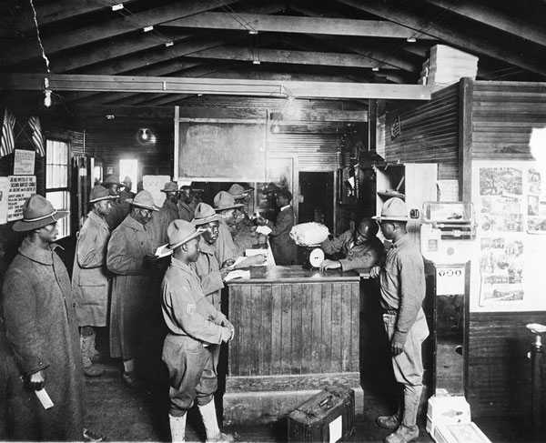
Most African Americans saw the war as an opportunity to demonstrate their patriotism and their place as equal citizens in the nation.

Slide 15
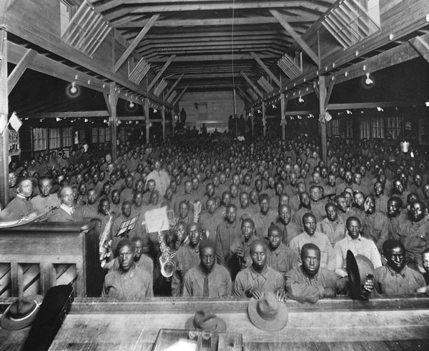
Black political leaders believed that if the race sacrificed for the war effort, the government would have no choice but to reward them with greater civil rights.

Slide 16
"Colored folks should be patriotic," the Richmond Planet insisted. "Do not let us be chargeable with being disloyal to the flag."

Slide 17
Black men and women for the most part approached the war with a sense of civic duty.
Over one million African Americans responded to their draft calls, and roughly 370,000 black men were inducted into the army.
Charles Brodnax, a farmer from Virginia recalled, "I felt that I belonged to the Government of my country and should answer to the call and obey the orders in defense of Democracy."

Slide 18
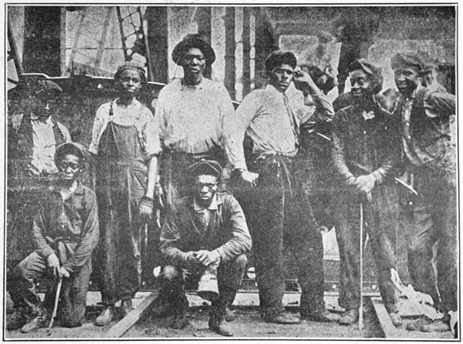
There were, however, large segments of AAs that remained hesitant to support a cause they deemed hypocritical.
There were even a small but vocal number of AAs that explicitly opposed black participation in the war.

Slide 19
Many other African Americans viewed the war apathetically and found ways to avoid military service.
As a black resident from Harlem quipped, "The Germans ain't done nothin' to me, and if they have, I forgive 'em."

Slide 20
Segregation in the Armed forces and Racial Violence

